Slide 1
Microsoft Azure
Techlanders Solutions

Slide 2
Introduction to Cloud Computing
What is Cloud?

Slide 3
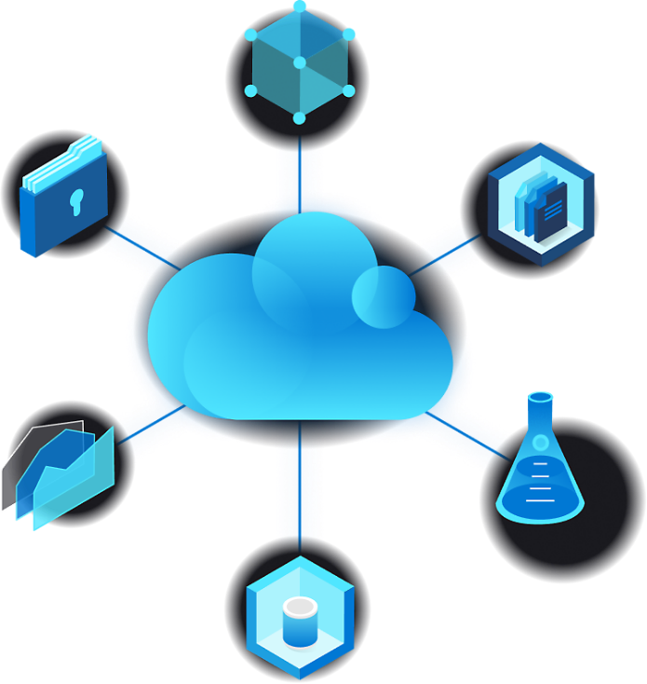
Introduction to Cloud Computing
Cloud computing refers to the delivery of computing services—including servers, storage, databases, networking, software, and more—over the internet. Instead of owning and maintaining physical servers or infrastructure, users can access these services on-demand from cloud service providers.

Slide 4
Top benefits of cloud computing
Cost
Global scale
Performance
Reliability
Speed
Productivity
Reliability

Slide 5
Traditional Data Centers
Techlanders Solutions

Slide 6
Traditional Vs Cloud Data Center
Consideration | On premises (Traditional) | Cloud
Upfront costs | Requires significant upfront investment. | Uses subscription, pay-as-you-go model.
Resource deployment | Resources managed and deployed in-house. | Deployment and management done on third-party infrastructure.
Security | Offers complete control of data and systems. | Offers high security but often doesn't meet specific regulatory requirements.
Compliance | Offers better visibility and storage options to meet compliance policies. | Doesn't offer complete authority and transparency into data storage and usage, which often violates compliance policies.
Scalability | Offers less flexibility due to hardware and space limitations. | Automates scalability as needed, often without intervention.
Availability | Vulnerable to single points of failure and can have more downtime. | Better prevention and downtime recovery with continuous monitoring and built-in redundant systems.

Slide 7
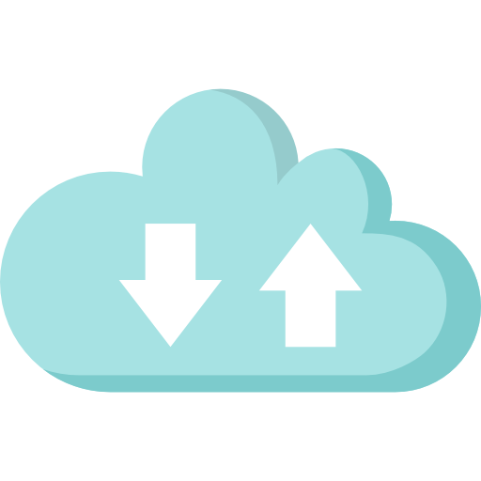



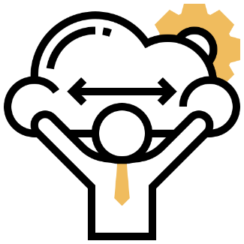
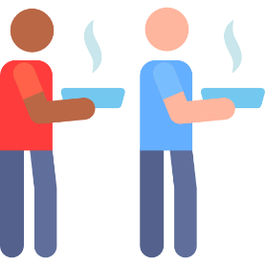
Cloud Essentials Characteristics
On-demand Self Service
Broad Network Access
Resource Pooling and Multi-tenancy
Scalability
Measured Service

Slide 8
On-demand self-service
It is based on a self-service model where users can manage their services like- allotted storage, functionalities, server uptime, etc., making users their own boss. The users can monitor their consumption and can select and use the tools and resources they require right away from the cloud portal itself.
Broad network access
Since cloud computing is accessible through the internet, it offers various services; one of them is broad network access. The users can access the network from anywhere. Moreover, they can use any devices such as mobile phones, tablets, office computers, and personal laptops, among others.

Slide 9
Scalability
Cloud computing provides scalability of resources to businesses. It helps in reducing costs and reduces business resource wastage. The automated processes also ensure that all the business activities get adequate resources whenever it needs them.
Resource pooling
Multi-tenancy and resource pooling is another peculiar characteristic of cloud computing that helps in adding value to a business. It uses different systems, devices, networks, servers, and applications to serve the requirement of different customers. It is done with the help of a multi-tenancy model, which allows customers to share the same infrastructure at the same time.

Slide 10
Measured services
Cloud resources and services such as storage, bandwidth, processing power, networking capabilities, intelligence, software and services, development tools, analytics, etc. used by the consumer are monitored and analyzed by the service providers. In other words, the services you use are measured. The users are then charged based on the resources used at the end of the month (or billing date). This model is called the pay-as-you-go subscription model.

Slide 11
Types of Cloud Computing

Slide 12
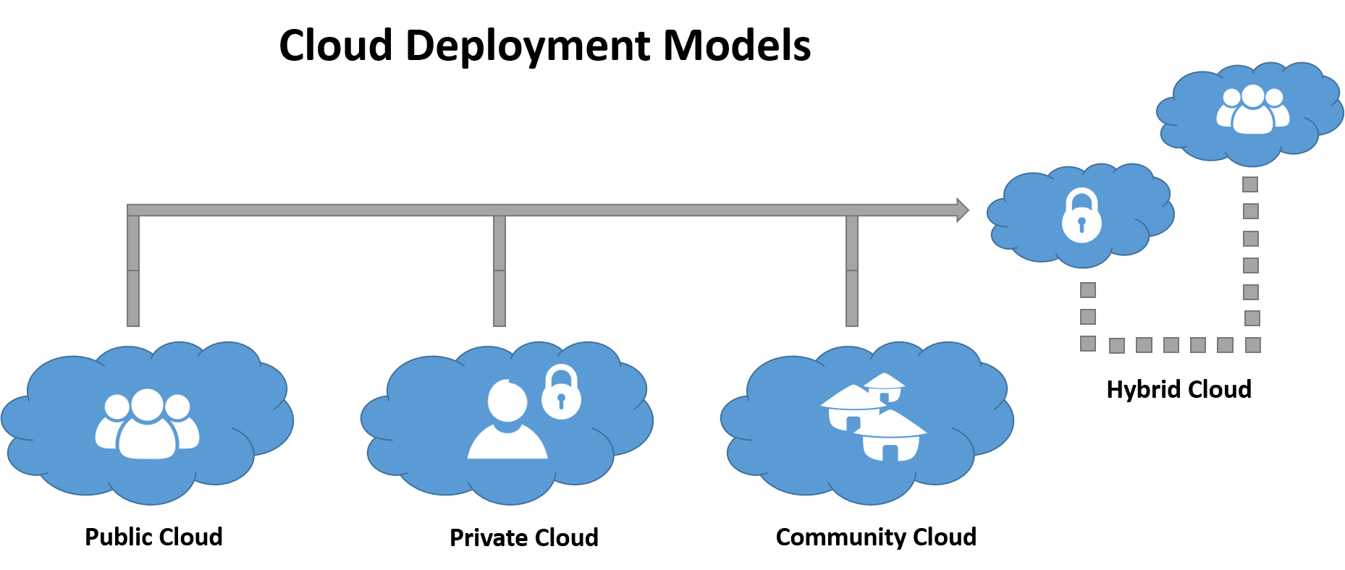

Types of Cloud Computing
There are the following 4 types of cloud that you can deploy according to the organization's needs-
Public Cloud
Private Cloud
Hybrid Cloud
Community Cloud

Slide 13
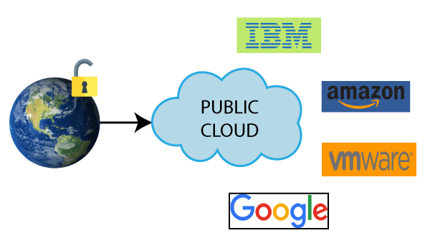
Public Cloud
Public cloud is open to all to store and access information via the Internet using the pay-per-usage method.
Public cloud is maintained by the cloud service provider.
Public cloud is easier to integrate. Hence it offers a better flexibility approach to consumers.
Public cloud is location independent because its services are delivered through the internet.
Public cloud is highly scalable as per the requirement of computing resources.
It is accessible by the general public, so there is no limit to the number of users.

Slide 14
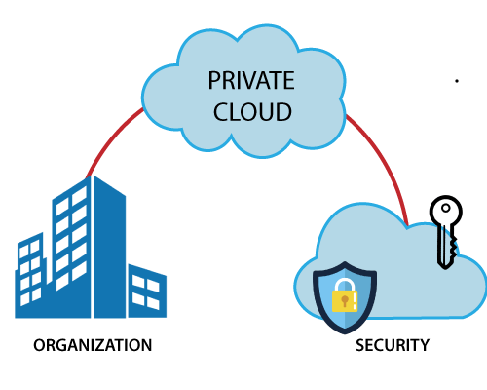
Private Cloud
Private cloud is also known as an internal cloud or corporate cloud. It is used by organizations to build and manage their own data centers internally or by the third party. It can be deployed using Opensource tools such as Openstack and Eucalyptus.
Private cloud provides a high level of security and privacy to the users.
Private cloud offers better performance with improved speed and space capacity.
It allows the IT team to quickly allocate and deliver on-demand IT resources.
The organization has full control over the cloud because it is managed by the organization itself. So, there is no need for the organization to depends on anybody.
It is suitable for organizations that require a separate cloud for their personal use and data security is the first priority

Slide 15
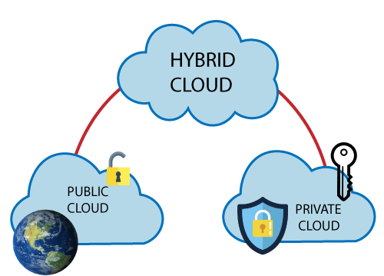
Hybrid Cloud
Hybrid cloud is a combination of public and private clouds.
The main aim to combine these cloud (Public and Private) is to create a unified, automated, and well-managed computing environment.
In the Hybrid cloud, non-critical activities are performed by the public cloud and critical activities are performed by the private cloud.
Mainly, a hybrid cloud is used in finance, healthcare, and Universities.
The best hybrid cloud provider companies are Amazon, Microsoft, Google, Cisco, and NetApp..

Slide 16
Community Cloud
Community cloud allows systems and services to be accessible by a group of several organizations to share the information between the organization and a specific community. It is owned, managed, and operated by one or more organizations in the community, a third party, or a combination of them.

Slide 17
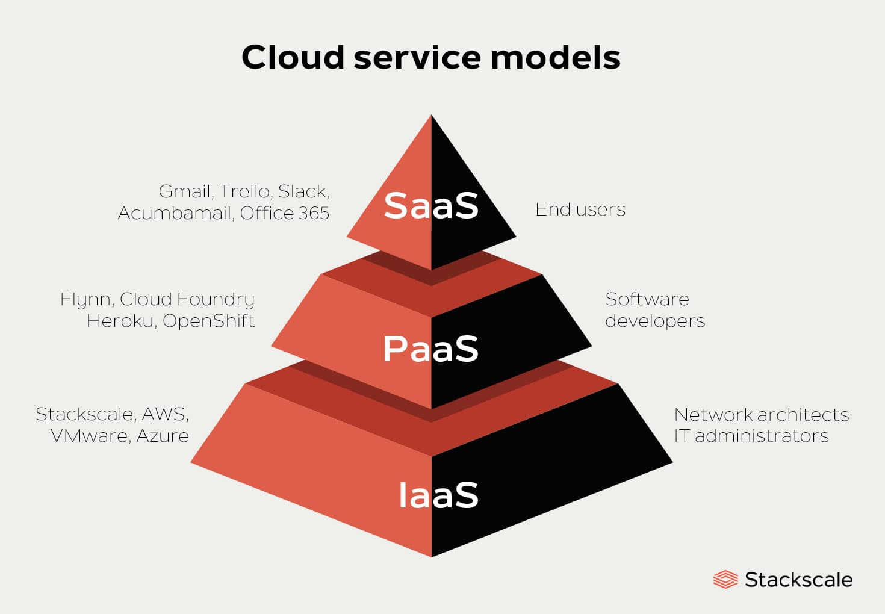
Cloud Service Models
There are three Cloud Computing Service Models:
Infrastructure as a Service (IaaS)
Platform as a Service (PaaS)
Software as a Service (SaaS)

Slide 18
Infrastructure as a Service (IaaS)
Cloud infrastructure services, known as Infrastructure as a Service (IaaS), are made of highly scalable and automated compute resources. IaaS is fully self-service for accessing and monitoring computers, networking, storage, and other services. IaaS allows businesses to purchase resources on-demand and as-needed instead of having to buy hardware outright.

Slide 19
IaaS - Benefits
Drastic reduction in capital investment
Easily Scalable
Pay only for the used resources
High Flexibility
Reduced infrastructure support teams

Slide 20
Platform as a Service (PaaS)
Platform As A Service (PAAS) is a cloud delivery model for applications composed of services managed by a third party. It provides elastic scaling of your application which allows developers to build applications and services over the internet and the deployment models include public, private and hybrid.

Slide 21
PaaS - Benefits
Includes all IaaS benefits
No upfront licensing cost
More reduction in Infrastructure support team
Rapid time to market

Slide 22
Software as a Service (SaaS)
Software As A Service (SAAS) allows users to run existing online applications and it is a model software that is deployed as a hosting service and is accessed over Output Rephrased/Re-written Text the internet or software delivery model during which software and its associated data are hosted centrally and accessed using their client, usually an online browser over the web. SAAS services are used for the development and deployment of modern applications.

Slide 23
SaaS - Benefits
Includes all discussed benefits which we get in PaaS
Ability to access from anywhere
Ability to access from multiple devices
No installations and maintenance requirements
No Application management/Licensing Required

Slide 24
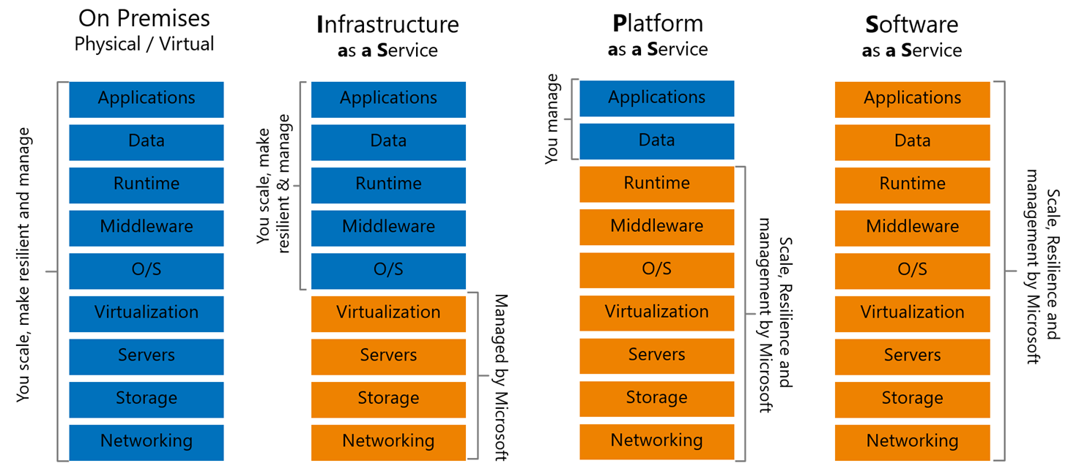
Responsibility- Who owns What?
Techlanders Solutions

Slide 25
Knowledge Checks
Which Service Level (IaaS, PaaS, SaaS) provides you most control?
What is Hybrid Cloud?
Can two public clouds be connected?
Connecting two public clouds, will be know as public cloud or Hybrid?
Cloud provided Database, is a PaaS or SaaS?

Slide 26
Microsoft Azure

Slide 27
Microsoft Azure Cloud
Microsoft Azure, formerly known as Windows Azure, is Microsoft's public cloud computing platform.
It provides a broad range of cloud services, including compute, analytics, storage and networking. Users can pick and choose from these services to develop and scale new applications or run existing applications in the public cloud.
Azure offers four different forms of cloud computing: infrastructure as a service (IaaS), platform as a service (PaaS), software as a service (SaaS) and serverless functions.
Microsoft charges for Azure on a pay-as-you-go (PAYG) basis, meaning subscribers receive a bill each month that only charges them for the specific resources and services they have used.
Microsoft unveiled Windows Azure in early October 2008 but it went to live after February 2010. Later in 2014, Microsoft changed its name from Windows Azure to Microsoft Azure.

Slide 28
Why Microsoft Azure?
Low Cost: Azure offers, pay as you go pricing. Azure models are usually cheapest among other service providers in the market.
Instant Elasticity: You need 1 server or 1000’s of servers, Azure has a massive infrastructure at backend to serve almost any kind of infrastructure demands, with pay for what you use policy.
Scalability: Facing some resource issues, no problem within seconds you can scale up the resources and improve your application performance. This cannot be compared with traditional IT datacenters.
Multiple OS’s: Choice and use any supported Operating systems.
Multiple Storage Options: Choice of high I/O storage, low cost storage. All is available in Azure, use and pay what you want to use with almost any scalability.
Secure: Azure is PCI DSS Level1, ISO 27001, FISMA Moderate, HIPAA, SAS 70 Type II passed. In-fact systems based on AWS are usually more secure than in-house IT infrastructure systems.

Slide 29
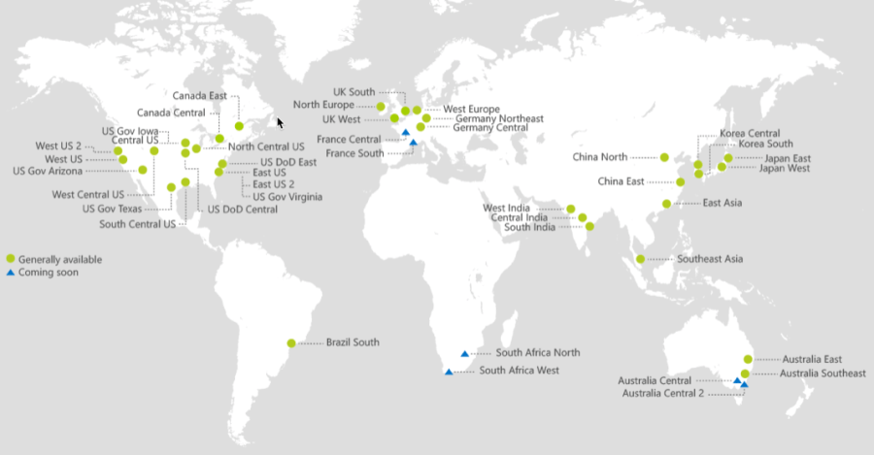
Azure Regions
Microsoft Azure is available in 60+ regions globally, with additional regions in the works to be added soon. These Azure Regions are basically geographic groupings of 2, 3, or more data centers.
When provisioning any cloud resource within Microsoft Azure it must be placed in, and reside within, an Azure Region.

Slide 30
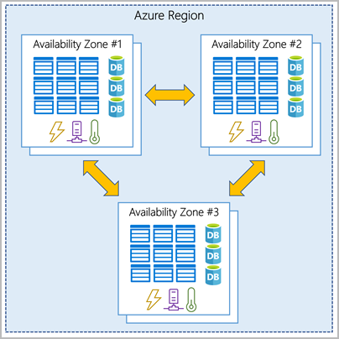
Azure Availability Zones
Availability Zones are multiple, isolated locations within each Region.
Azure Availability Zones are separate data center units within Microsoft Azure, each with its own power, cooling and networking. By running services on multiple availability zones, you can make your applications resilient to failure or disruption in your primary data center.

Slide 31
Azure Availability Set
An availability set is a logical grouping of virtual machines (VMs) that are deployed across multiple fault domains and update domains.
Each availability set can be configured with up to three fault domains and twenty update domains.
These configurations can't be changed once the availability set has been created.
Update domains indicate groups of virtual machines and underlying physical hardware that can be rebooted at the same time.
Fault domains define the group of virtual machines that share a common power source and network switch
The purpose of an availability set is to enhance the reliability and availability of applications and services by minimizing the impact of hardware or software failures and planned maintenance events.

Slide 32
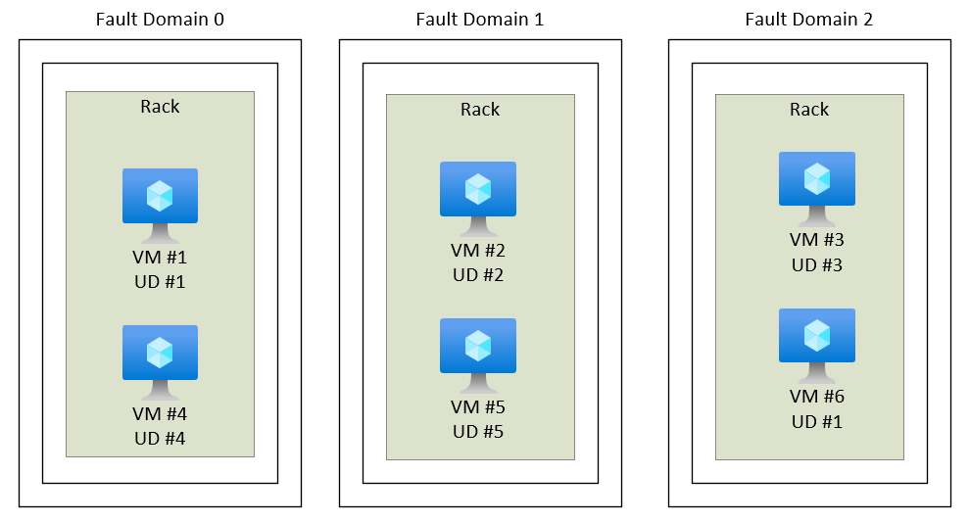
Azure Availability Set

Slide 33
Azure Subscriptions
Azure Subscriptions are a logical unit of Azure services that are linked to an Azure account.
An Azure subscription is linked to a single account, the one that was used to create the subscription and is used for billing purposes. Within the subscription, resources can be provisioned as instances of the many Azure products and services.
You can have more than one subscription, often for billing purposes, since each subscription generates its own set of billing reports and invoices.
The person who creates an Azure subscription becomes the global administrator for that subscription and has full access to every aspect of that subscription hence separate subscriptions can also be a way to create a division of responsibility for Azure services

Slide 34
Management Group
If your organization has many subscriptions, you may need a way to efficiently manage access, policies, and compliance for those subscriptions.
Azure management groups provide a level of scope above subscriptions.
You organize subscriptions into containers called "management groups" and apply your governance conditions to . the management groups.
All subscriptions within a management group automatically inherit the conditions applied to the managementgroup.
All subscriptions within a single management group must trust the same Azure Active Directory tenant.
For example, you can apply policies to a management group that limits the regions available for virtual machine (VM) creation. This policy would be applied to all management groups, subscriptions, and resources under that management group by only allowing VMs to be created in that region.
This security policy cannot be altered by the resource or subscription owner allowing for improved governance.

Slide 35
Resource Group
A resource group is a container that holds related resources for an Azure solution. The resource group can include all the resources for the solution, or only those resources that you want to manage as a group.
The resource group stores metadata about the resources. Therefore, when you specify a location for the resource group, you are specifying where that metadata is stored. For compliance reasons, you may need to ensure that your data is stored in a particular region.

Slide 36
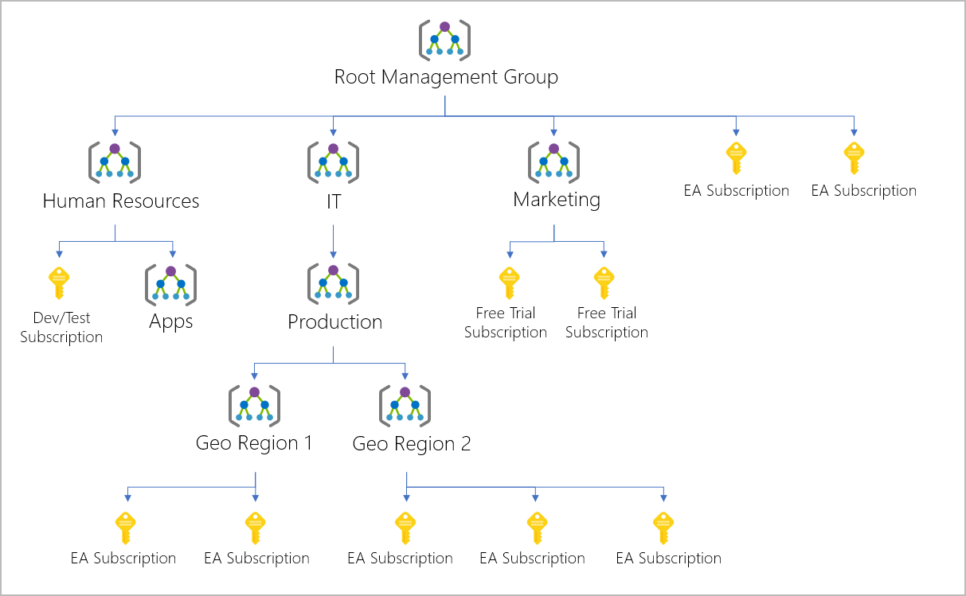
Management Group , Subscription and Resource Group

Slide 37
Important facts about management groups
10,000 management groups can be supported in a single directory.
A management group tree can support up to six levels of depth.
This limit doesn't include the Root level or the subscription level.
Each management group and subscription can only support one parent.
Each management group can have many children.

Slide 38
Root management group for each directory
Each directory is given a single top-level management group called the "Root" management group.
This root management group is built into the hierarchy to have all management groups and subscriptions fold up to it.
By default, the root management group's display name is Tenant root group.
To change the display name, your account must be assigned the Owner or Contributor role on the root management group.
No one is given default access to the root management group. Azure AD Global Administrators are the only users that can elevate themselves to gain access.
Once they have access to the root management group, the global administrators can assign any Azure role to other users to manage it.

Slide 39
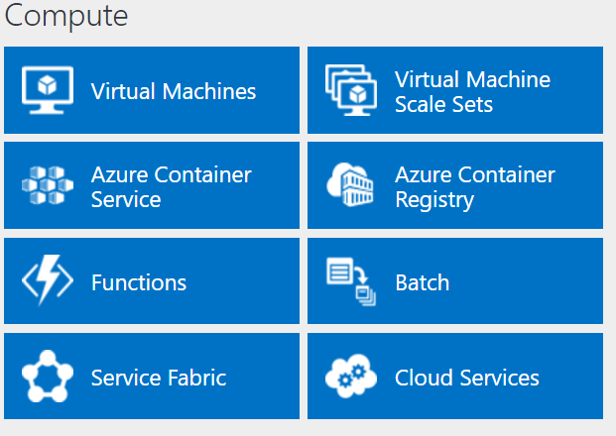
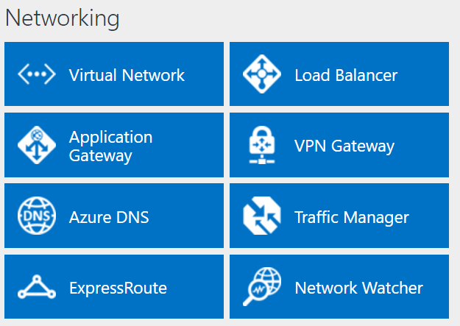
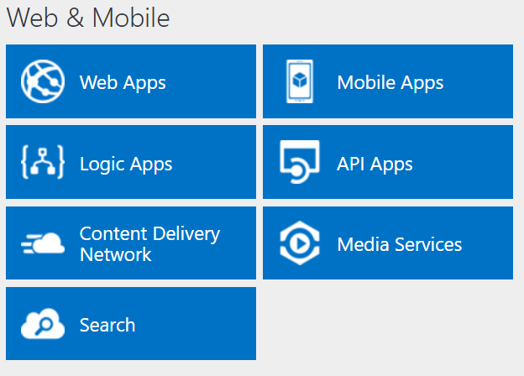
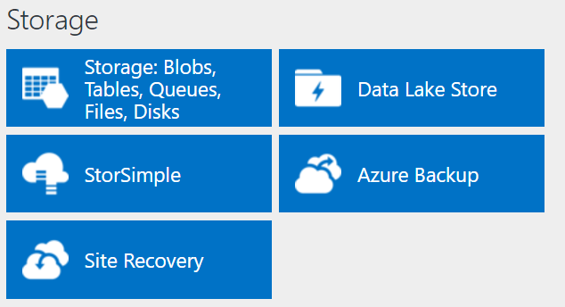
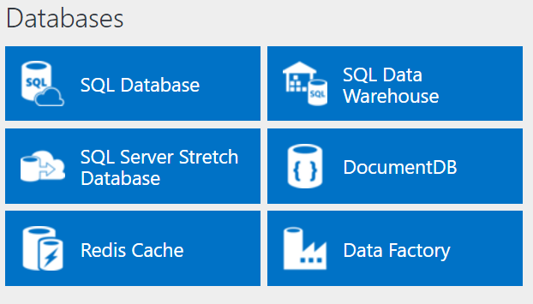
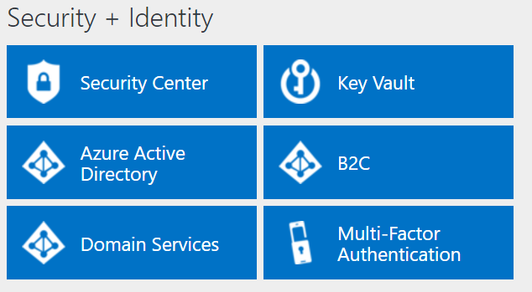
Services Offered

Slide 40
Microsoft Azure VMs
An Azure virtual machine gives you the flexibility of virtualization without having to buy and maintain the physical hardware that runs it. However, you still need to maintain the virtual machine by performing tasks, such as configuring, patching, and installing the software that runs on it.

Slide 41
Azure VM
Azure Virtual Machines supports the deployment of Windows or Linux virtual machines (VMs) in a Microsoft Azure datacenter.
You have total control over the configuration of the VM. You are responsible for all server software installation, configuration, and maintenance and for operating system patches.
Because of the level of control afforded to the user and the use of durable disks, VMs are ideal for a wide range of server workloads that do not fit into a PaaS model.
Microsoft offers a 99.95 percent connectivity service level agreement (SLA) for multiple-instance VMs deployed. That means that for the SLA to apply, there must be at least two instances of the VM deployed within an availability set.

Slide 42
Azure VM
Azure Virtual Machines is priced on a per-hour basis, but it is billed on a per-minute basis. For example, you are only charged for 23 minutes of usage if the VM is deployed for 23 minutes.
The cost for a VM includes the charge for the Windows operating system. Linux-based instances are slightly cheaper because there is no operating system license charge.
The cost, and the appropriate licensing, for any additional software you install is your responsibility.
Some VM images, such as Microsoft SQL Server, you acquire from the Azure Marketplace may include an additional license cost (on top of the base cost of the VM).

